Slide 1


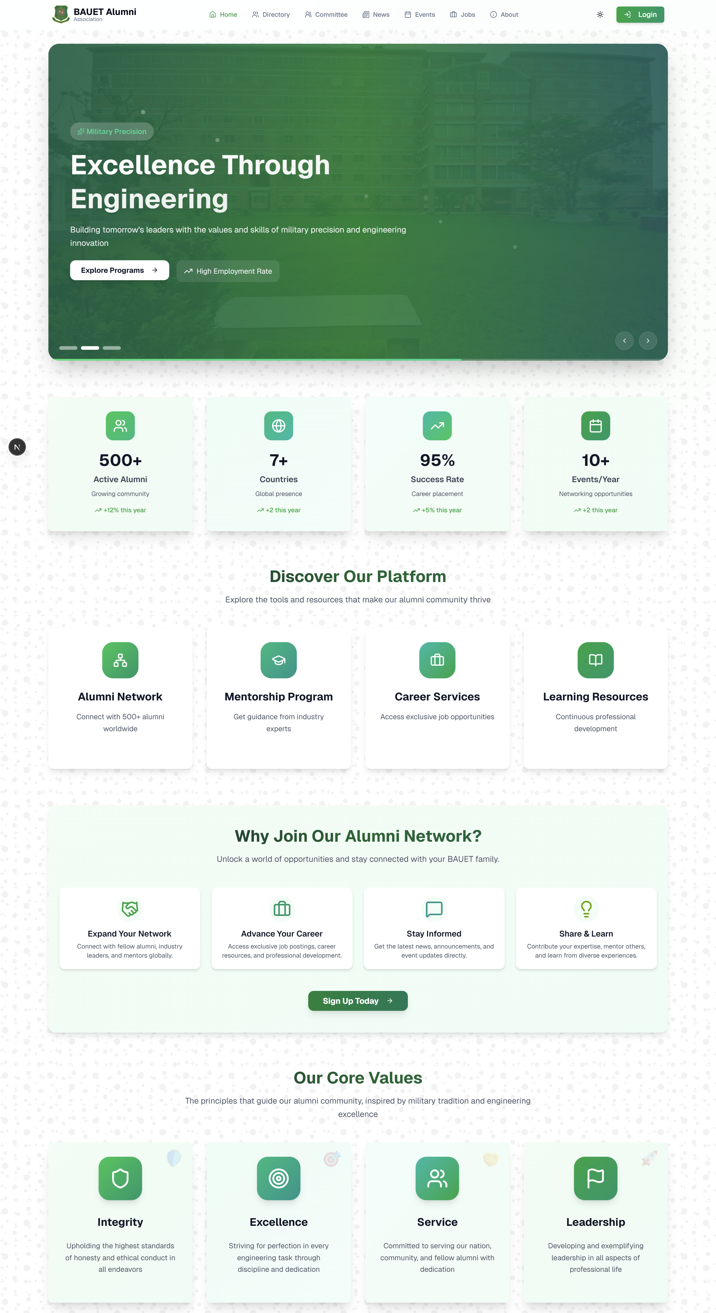
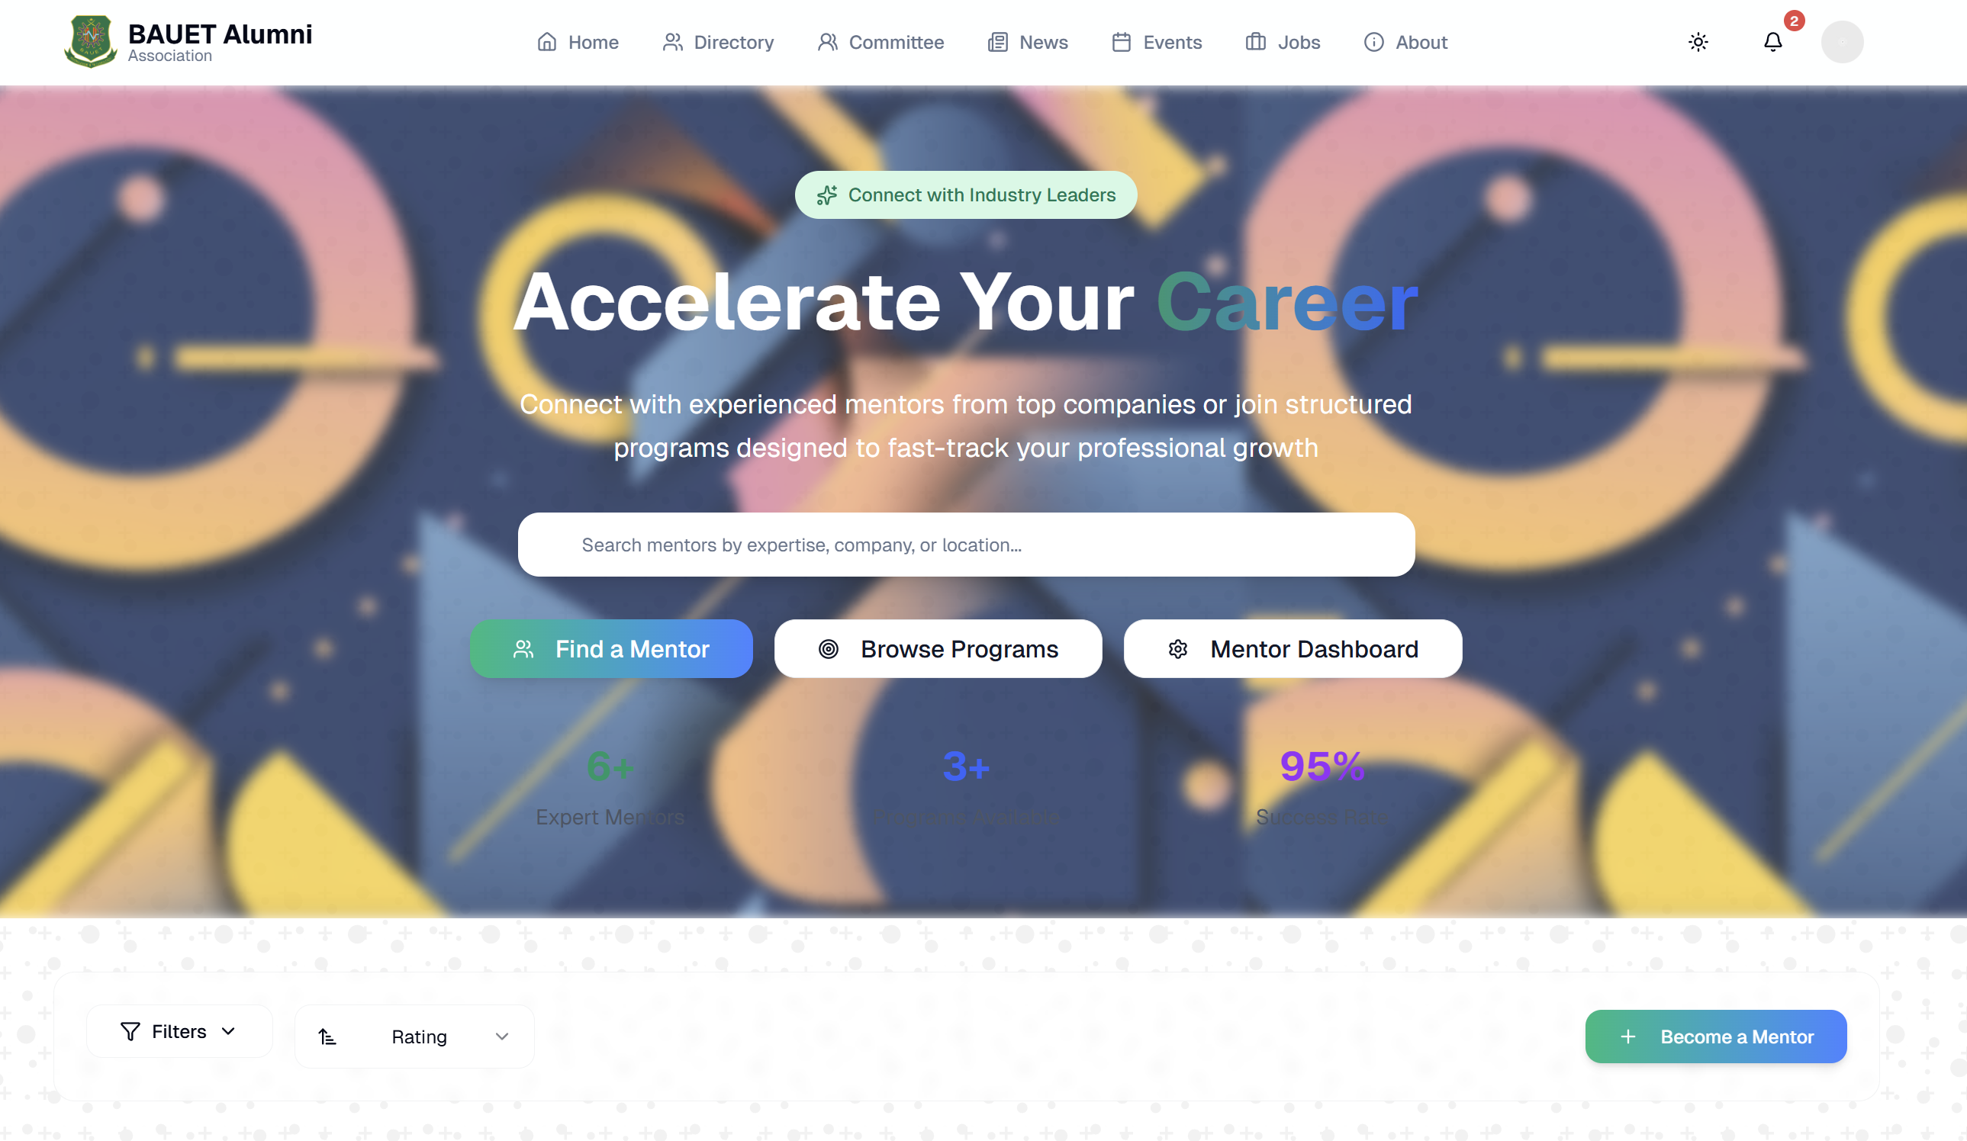
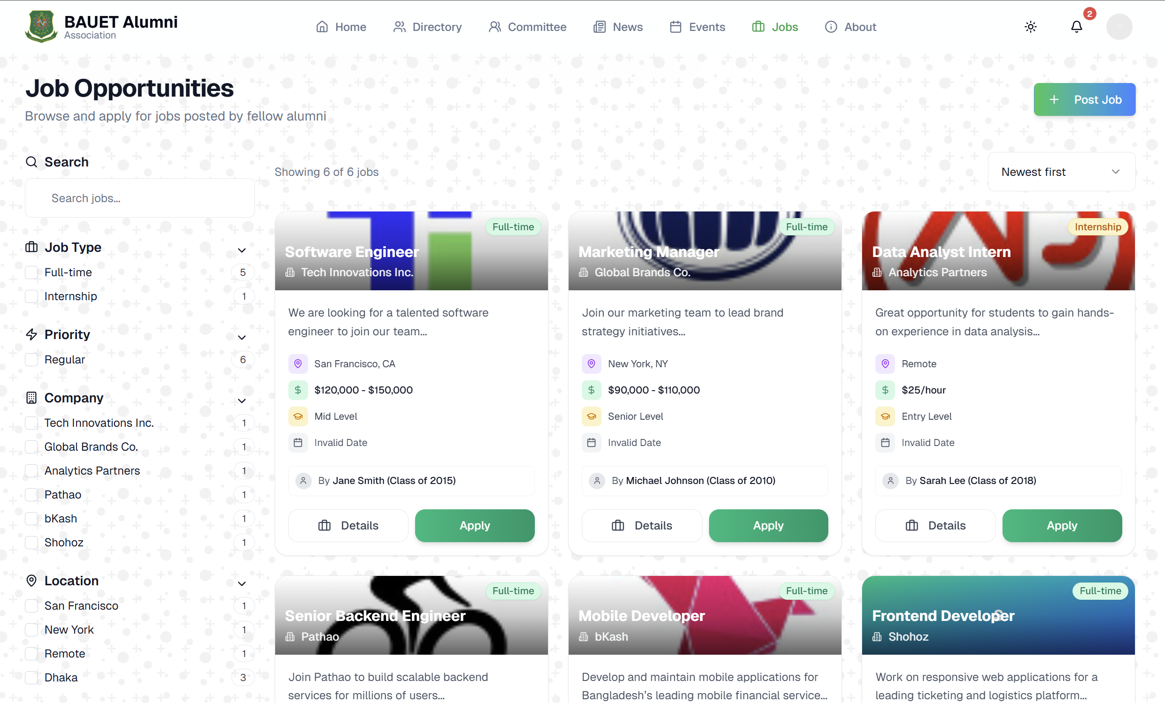
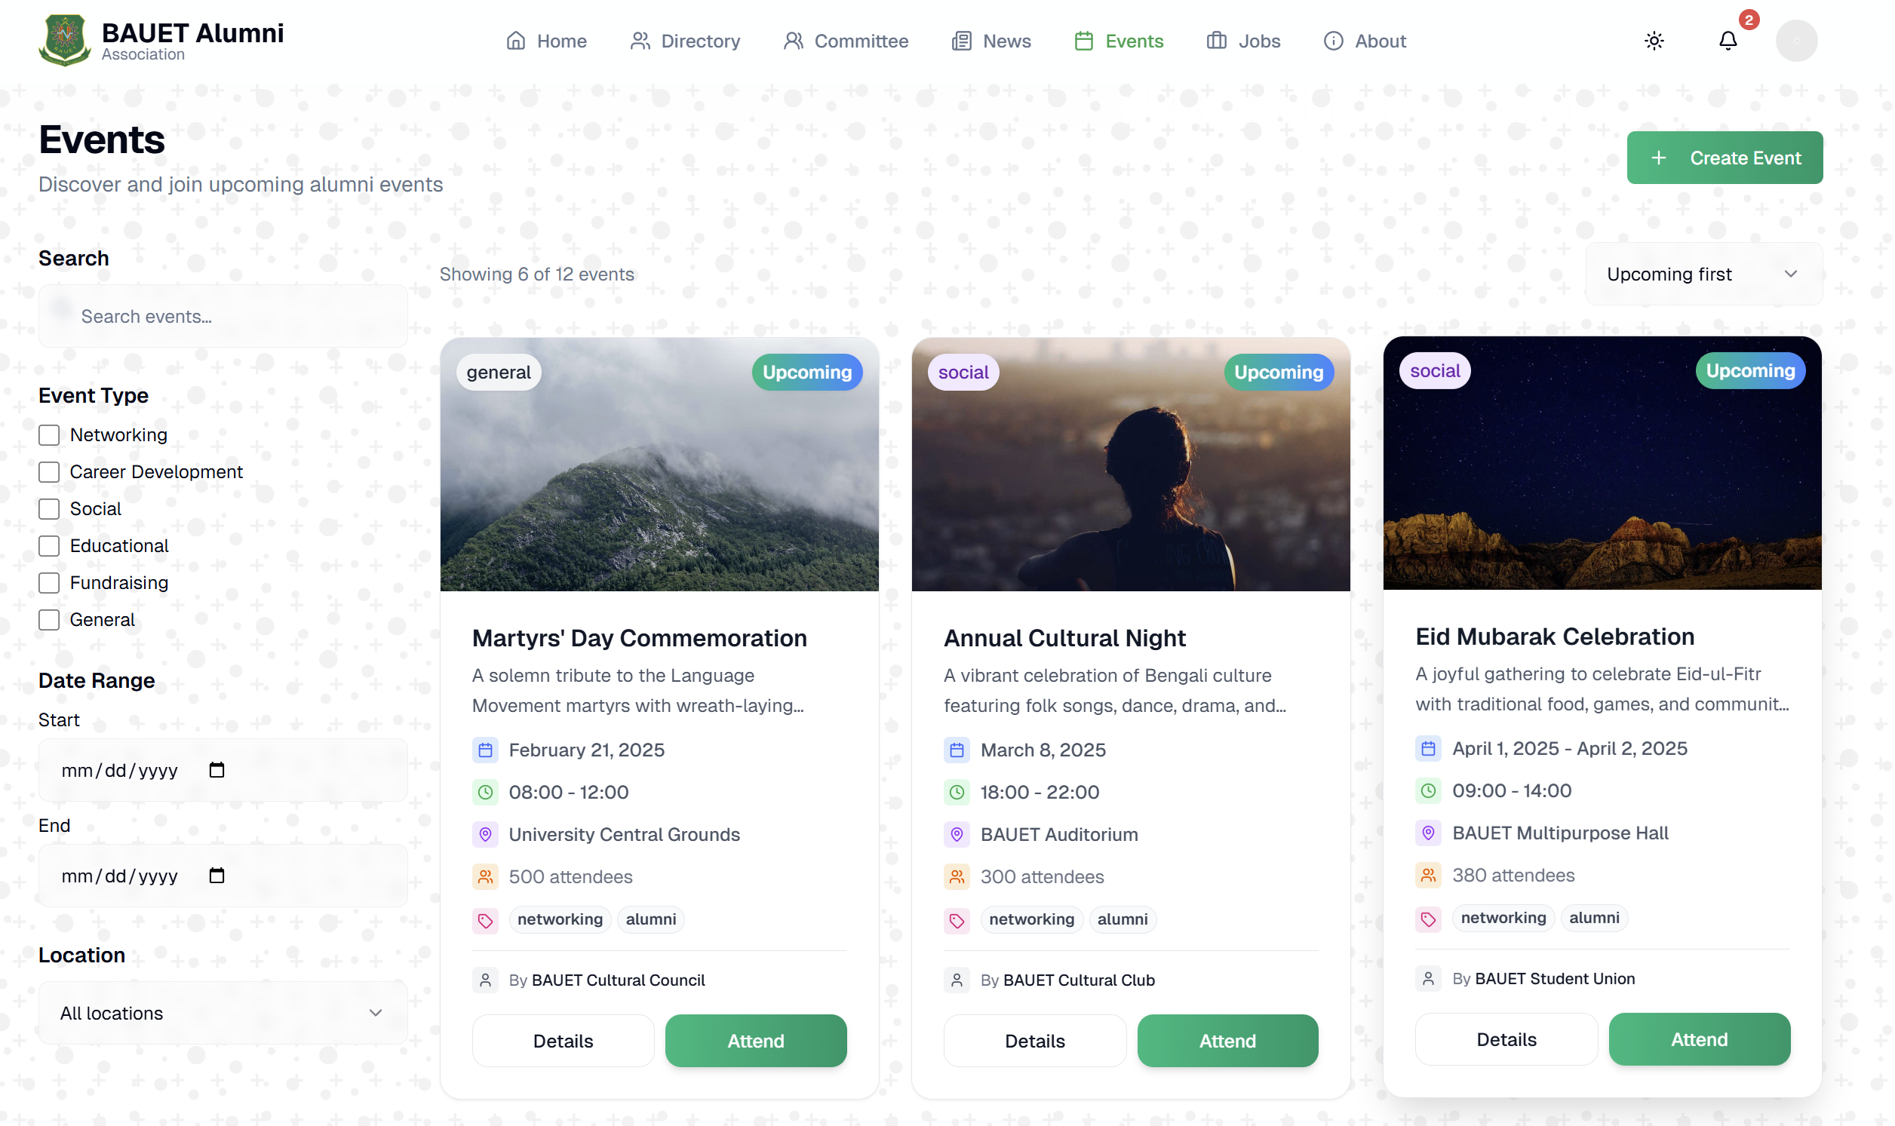
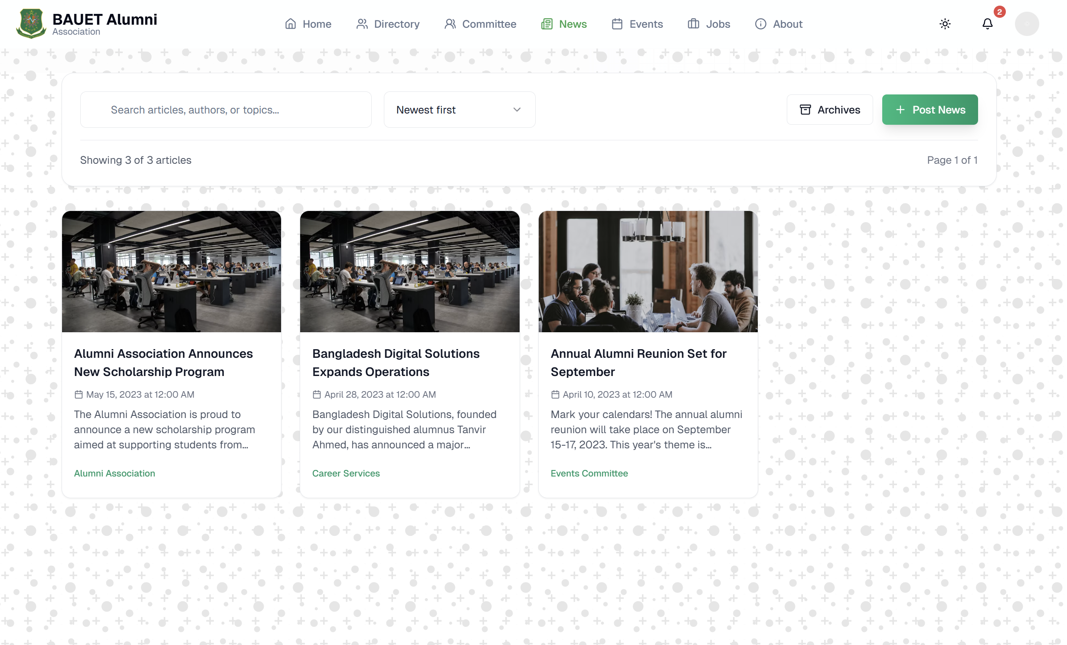
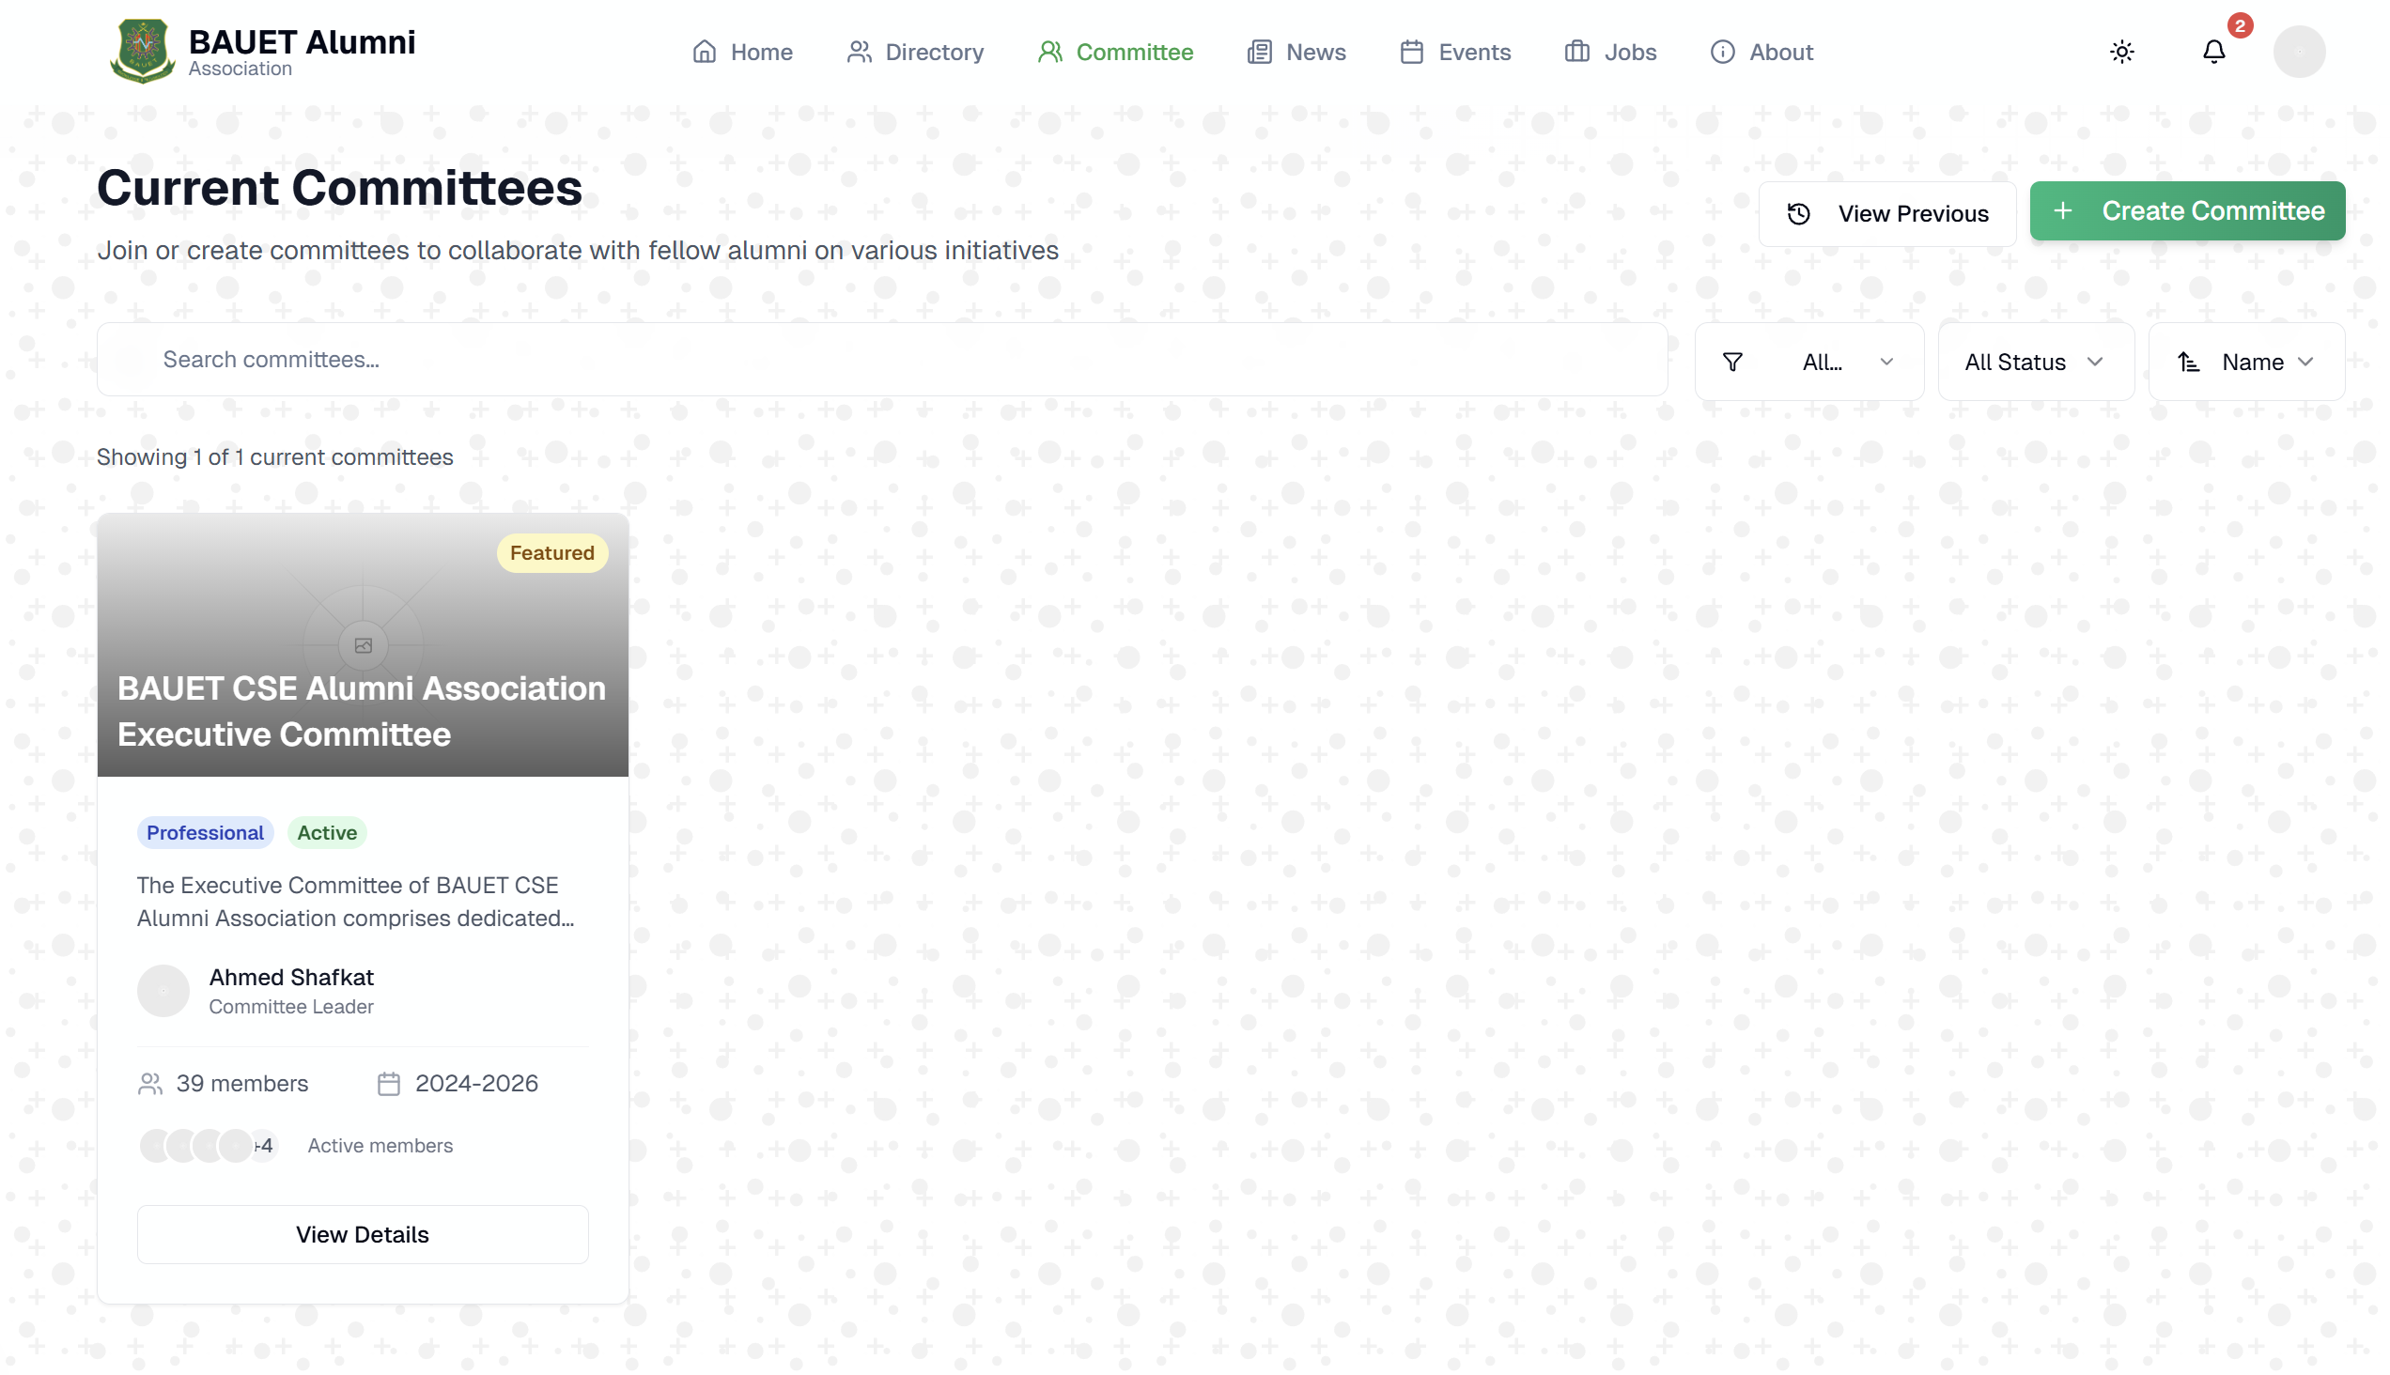
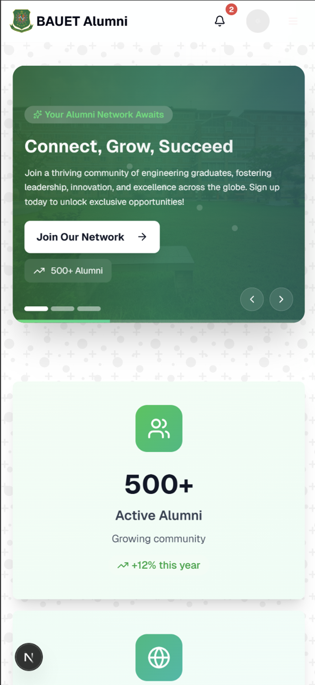
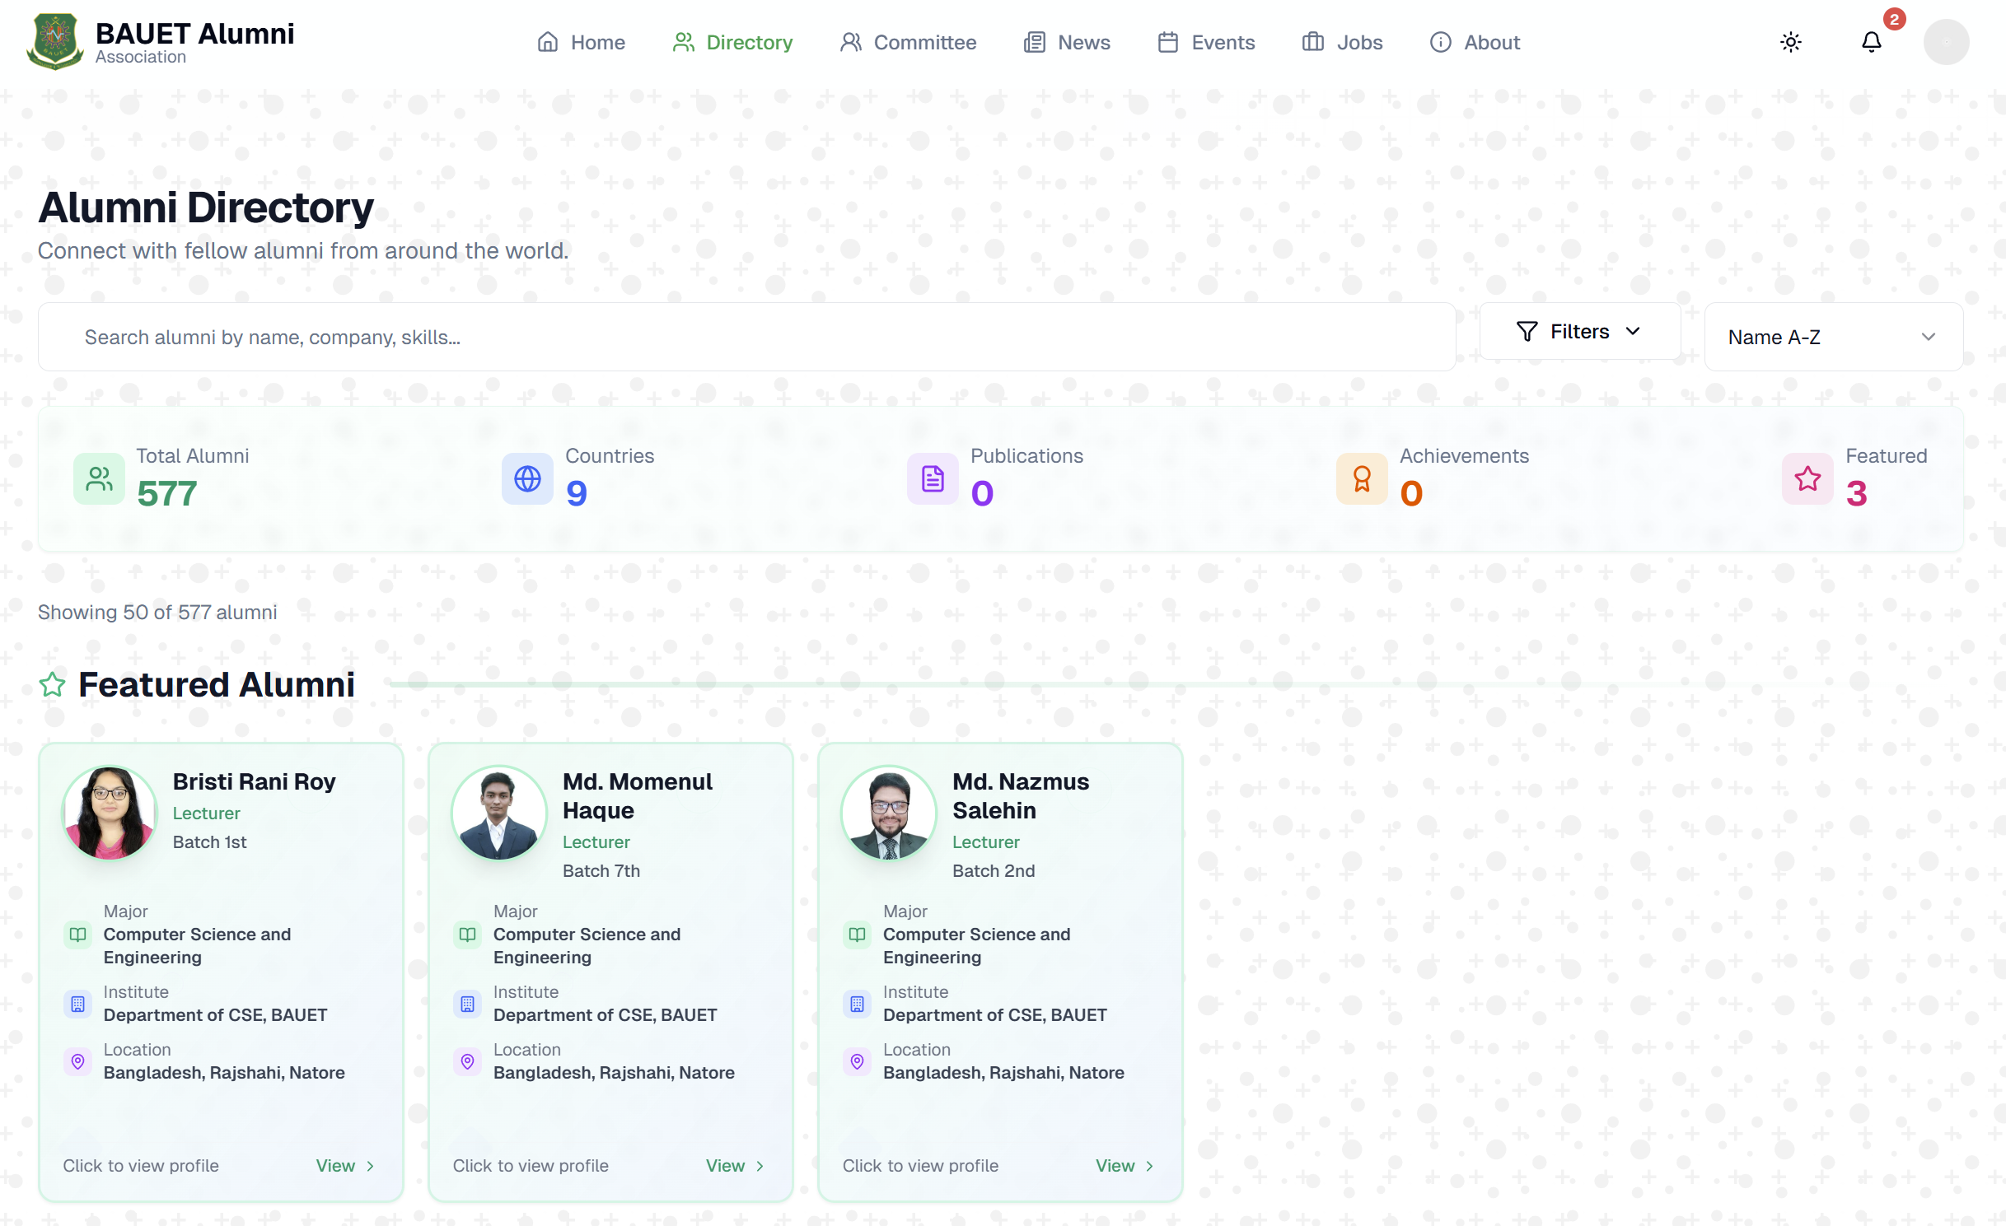
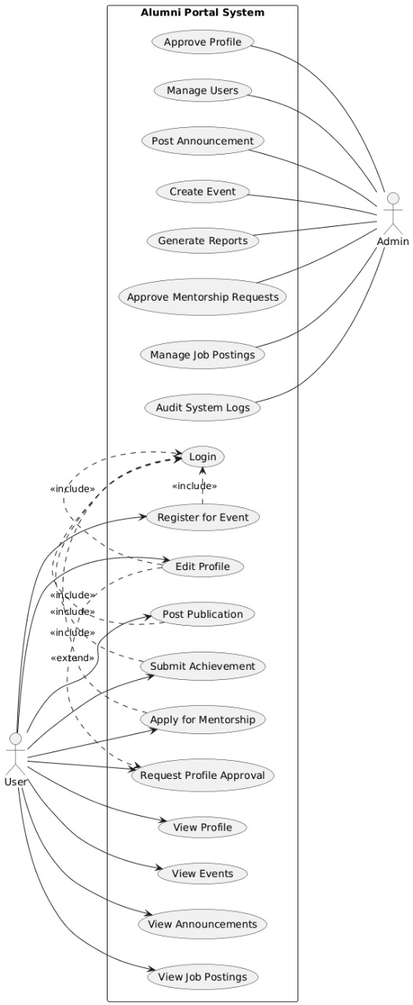



Bangladesh army university of engineering & technology ( BAUET)
Course code: cse-3102 Course title: software engineering and information system design laboratory
ALUMNI MANAGEMENT PORTAL
(Project Name: Alumni Association)
Introduction
A comprehensive Alumni Management Portal developed for Bangladesh Army University of Engineering & Technology
Designed to streamline:
Networking
Alumni Engagement
Institutional Collaboration
Fig.1: Design Preview
Objectives
Advantages
Use Case Diagram
To design a secure and user-friendly alumni management portal
To centralize alumni data and streamline communication between alumni and the institution
To facilitate event organization, mentorship, and job-sharing through an integrated platform
To automate administrative processes and enhance engagement analytics for better decision-making
To ensure scalability, accessibility, and data protection across all devices
Centralized and easily searchable alumni database
Automated event management and mentorship matching
Strong authentication and data encryption
Cost-effective long-term maintenance with modular upgrades
Enhanced alumni participation and institutional branding
Analysis
Limitations
Information was gathered through:
Structured Interviews
Questionnaires
Direct Observation
The Dean of ECE Faculty (Prof. Mohammad Golam Sarwar Bhuyan) was interviewed to identify institutional needs and security requirements
A questionnaire survey was conducted among BAUET alumni to collect feedback on usability and feature preferences
Observation of existing alumni communication methods, such as social media and manual records, was carried out by the development team to identify current limitations and workflow gaps
Initial user onboarding and adoption may take time
High dependency on consistent internet connectivity
System Design
The system design was represented using Data Flow Diagrams (DFD), Use Case Diagrams, and Class Diagrams.
These methods were used to visualize data movement, user interactions, and system structure
Fig.2: Use Case Diagram
Feasibility
Conclusion
Group 02
The project is technically and operationally feasible within a BDT 500,000 budget
Economic evaluation predicts gradual cost recovery through efficiency gains, reduced administrative workload, and increased fundraising and sponsorships
Estimated Payback Period : 6 years
Cumulative Benefit by Year 6 : ≈670,000 BDT
Net Positive Return : ≈260,000 BDT
The Alumni Management Portal was found to be feasible, effective, and aligned with institutional goals
It successfully addressed communication gaps, improved data management, and enhanced alumni engagement through automation and centralized access
Overall, the system proved technically sound, economically viable, and valuable for long-term institutional growth
Khondokar Mishkatul Azim ID: 0812310205101028
Zarif Ahnaf Dhrubo
ID: 0812310205101023
Md. Muhiminul Islam
ID: 0812310205101006

